Slide 1


Coupled Problems Semester Project
Insulated Plate
Bahadir Eryilmaz (3125111)
Philip Bottke (3048670)
Vashishth Shukla (3098673)

Slide 2
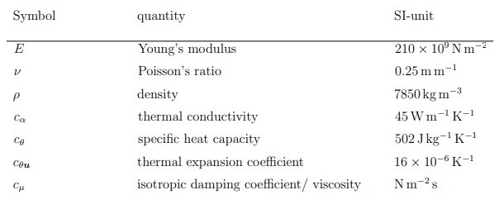
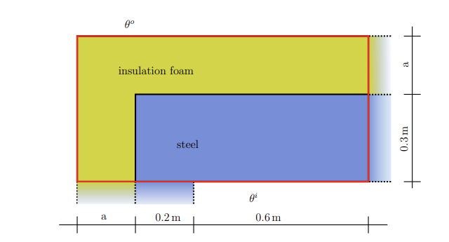
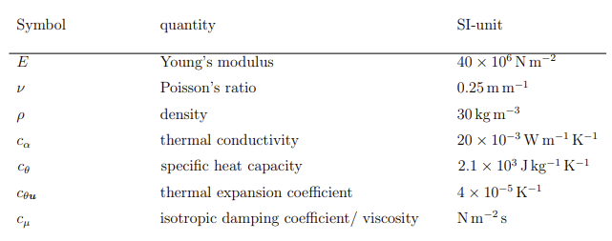
Problem definition
STEEL
FOAM

Slide 3
We have two cases for this model and for both cases we have some conditions. For the first case a steady-state analysis must be made. As for the second case, a transient analysis must be performed.
Our goals for static analysis:
Optimum thickness of foam.
Finding the critical region of the steel.
Our goals for the transient analysis:
Analyse the temperature and stress distributions over time
Discuss the transient effects

Slide 4
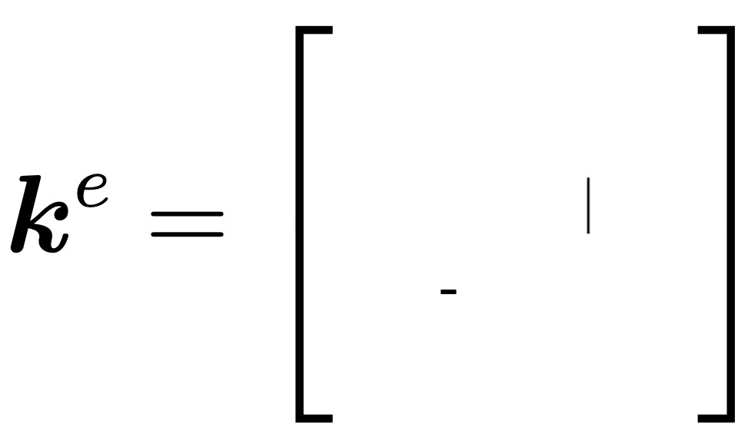
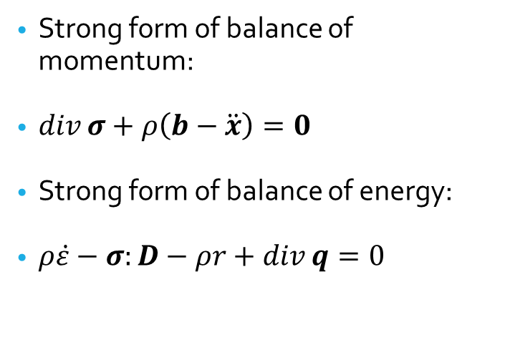
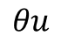
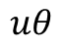
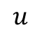
To solve both cases, we need to perform a finite element analysis. For that, we need balance of momentum and balance of energy.
Strong form of balance of momentum:
$\operatorname{div}{σ}+ρ\left(b−\ddot{x}\right)=0$
Strong form of balance of energy:
$ρ\dot{ε}−σ:D−ρr+\operatorname{div}{q=0}$
Since we need both balance laws, we must deal with coupling. It is important to note that generally coupled problems lead to non-symmetric system matrix which not all solvers can handle. Also, the simulation would be more expensive.
$$u$$
$$uθ$$
$$θ$$
$$θu$$

Slide 5
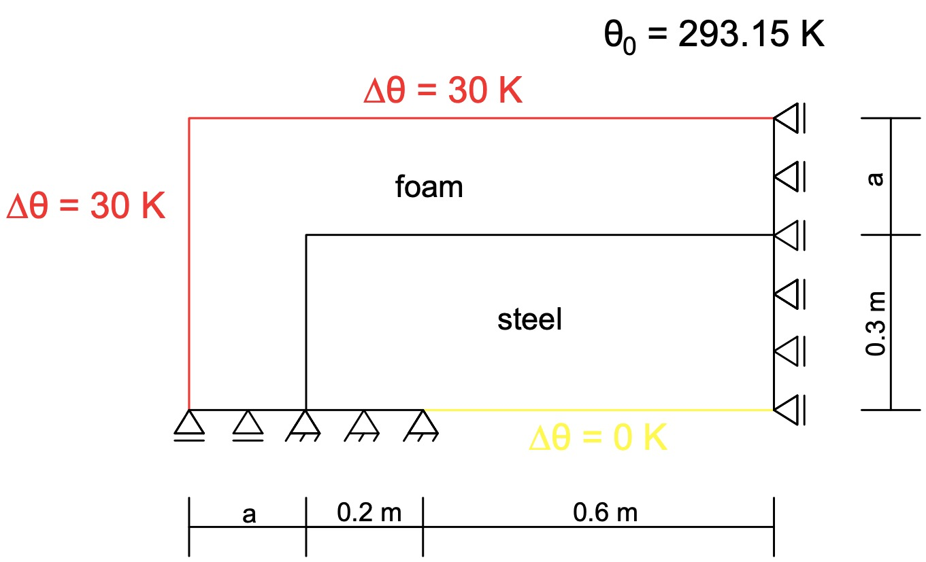
BOUNDARY CONDITIONS (STATIC)

Slide 6
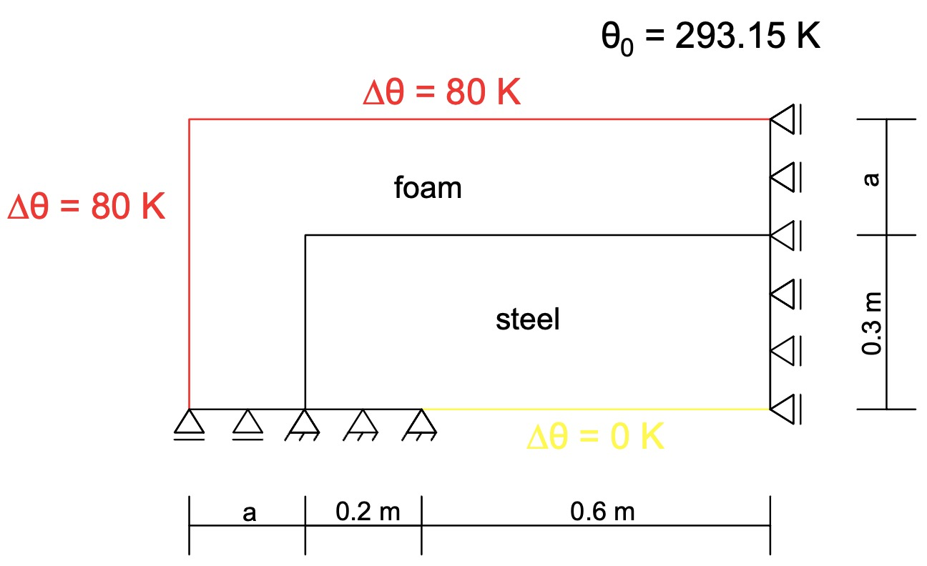
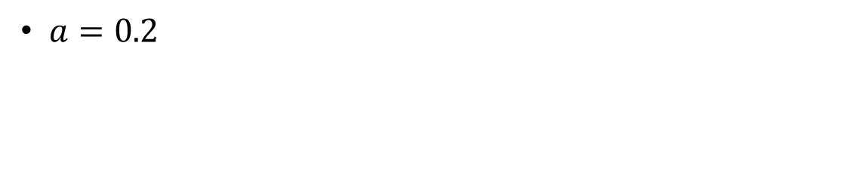
BOUNDARY CONDITIONS (DYNAMIC)
$a=0.2$

Slide 7

For this problem, we used python and PyFEMp package which is written by Sascha F. Maassen. PyFEMP (Python Finite Element Program) is a simple Finite Element program written in python. Its focus is on simplicity not on performance and it requires python version higher than 3.6.

Slide 8
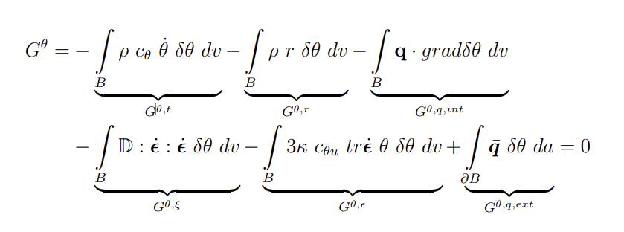
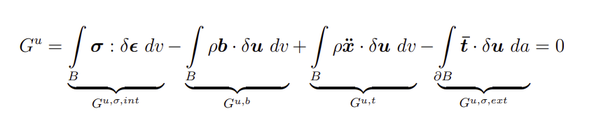
Weak Forms

Slide 9
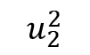
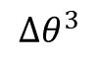
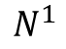
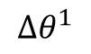
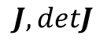
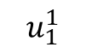
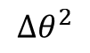
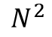
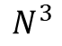
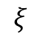
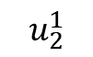
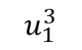
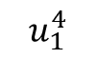
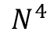
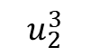
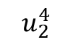
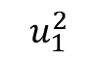
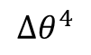
Finite Element Model
$$u_{2}^{3}$$
$$N^{4}$$
$$N^{3}$$
$$Δθ^{2}$$
$$u_{1}^{3}$$
$$J,detJ$$
$$η$$
$$u_{2}^{4}$$
$$u_{2}^{2}$$
$$ξ$$
$$Δθ^{4}$$
$$u_{1}^{4}$$
$$u_{1}^{2}$$
$$Δθ^{1}$$
$$u_{2}^{1}$$
$$N^{1}$$
$$N^{2}$$
$$Δθ^{3}$$
$$u_{1}^{1}$$
Notes:
Del thete … not change … but the dif … with respect to the reference temp.

Slide 10
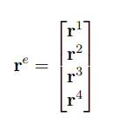
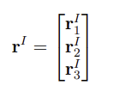
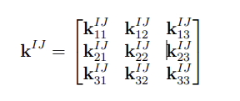
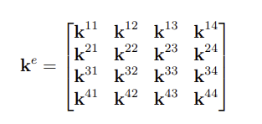
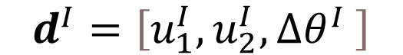
Element vector and element matrix
$$d^{I}=\left[u_{1}^{I},u_{2}^{I}, {∆θ}^{I} \right]$$

Slide 11
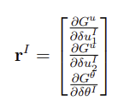
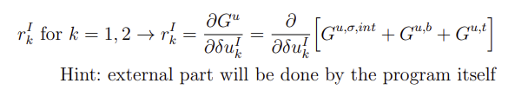
Derivation of Element Vector for BaMo

Slide 12
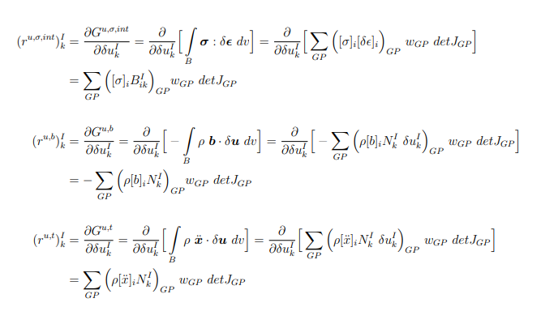

Slide 13
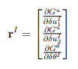
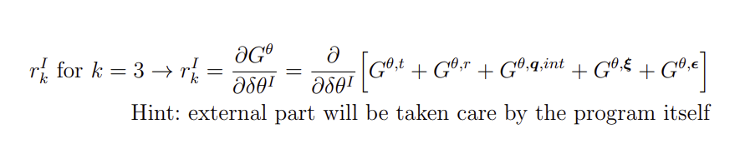
Derivation of Element Vector for BaEn

Slide 14
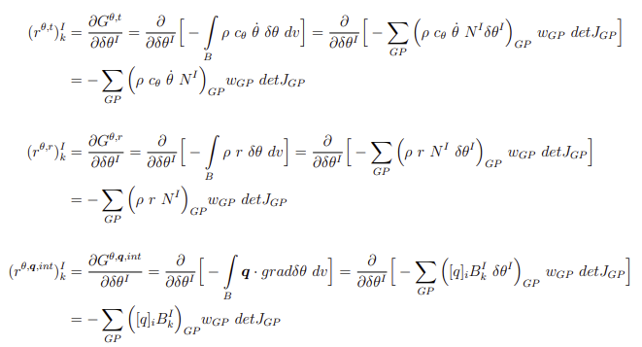

Slide 15
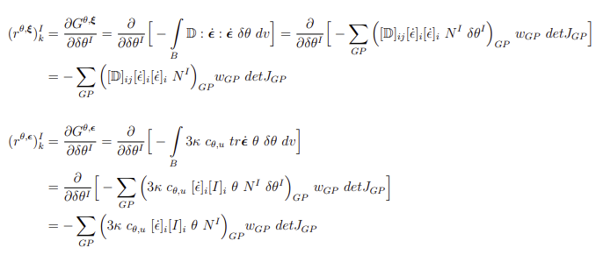

Slide 16
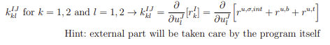
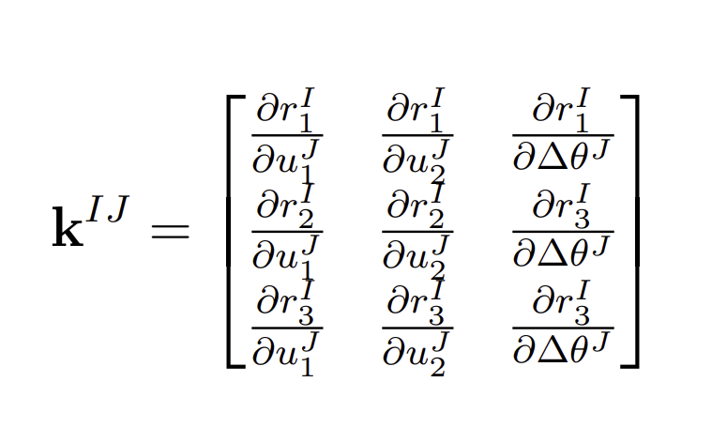
Derivation of element matrix for BaMo

Slide 17
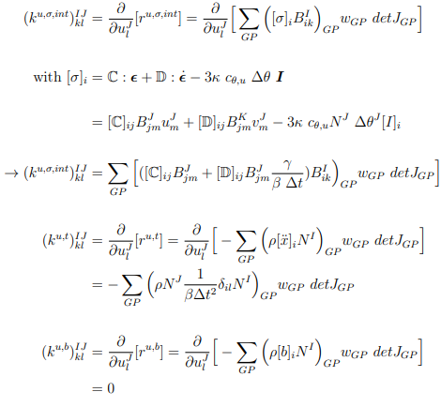

Slide 18
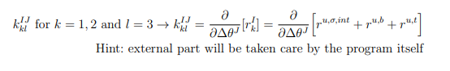
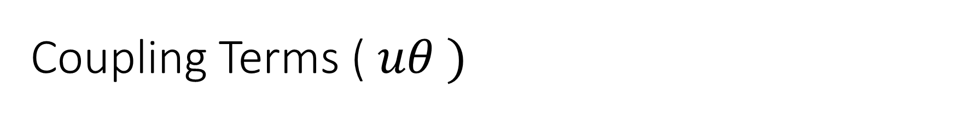
Coupling Terms ( $uθ )$

Slide 19
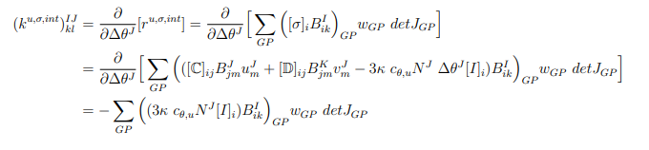
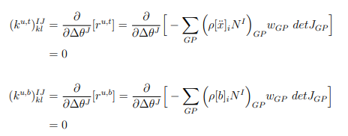

Slide 20


BaEn term $(θ)$

Slide 21


Slide 22


Slide 23


Coupling Terms ( $θu)$

Slide 24


Slide 25

Assumptions and Source of Errors
Primary assumptions:
2D, plane strain
Von misses theory of failure
Linear system:
Small deformations
No viscous damping
FEM discretization
Numerical errors
Newmark integration
Values in K matrix
Singular matrix
k not symmetric
Coarse mesh

Slide 26

Discussion of Stress Concentration
Notes:
This is not the steady-state response but the static solution … so the temperature distribution is the way it is in the graph on the left.
Max stress is at the point… as we have compression on the right side and expansion on the left so we expect more stress on the surface with the fixed support.

Slide 27

Mesh density n = 10

Slide 28

CONVERGENCE STUDY

Slide 29
A = 0.2
Notes:
This is not the steady-state response but the static solution … so the temperature distribution is the way it is in the graph on the left.
Max stress is at the point… as we have compression on the right side and expansion on the left so we expect more stress on the surface with the fixed support.

Slide 30

Results for dynamic analysis:
At ‘current time’ = 36000 s (10H) the von misses stress in the material is more than critical stress (3*10^5 MPa)
Notes:
In every Newmark integration points, we have new acceleration and thetadot values. We can inspect the distributions over time so that we can know at which point of time the material fails.

Slide 31

THANK YOU

